Slide 1
Predicting Traffic Accident Severity – Capstone Project

Slide 2
Introduction
background:
The modern world has become more attractive. one of the causes is the growth of vehicles. Huge amounts of vehicles should be a concern for us, humans. Every person wants his own mobility such as: car, cycles etc.
As the more vehicles drive the more accidents there become.

Slide 3
Introduction
The business Business Problem:
There are a lot of accidents in the world, most of them deadly. we want to know how these deadly accidents become so deadly.
We will explore the data and find some insights by building a model that predicts severity's accident.

Slide 4
Introduction
Interest:
This project will interest the Transportation Authority of Seattle USA.
The model will help to reduce the amount of deadly accidents.

Slide 5
DATA
the data contains all the Collisions from the years: 2004-2020 in siattle USA
I will use the following features to predict the severity:
location, persons' count, day/night, where happened (interchange, alley and etc).
all these features will help me to analyze the question.

Slide 6
Methodology
I chose to use logistic regression because the output is Yes or no (1 or 0)
so I believe that is the best optimal methodology.
In addition, I’ve also used “Decision Tree Classifier” to try achieve better model’s accuracy.

Slide 7
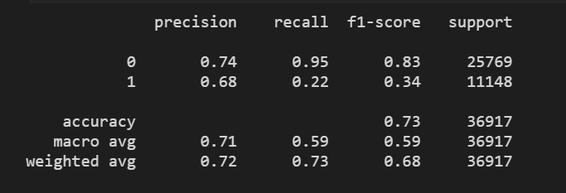
Results
Logistic regression -

Slide 8
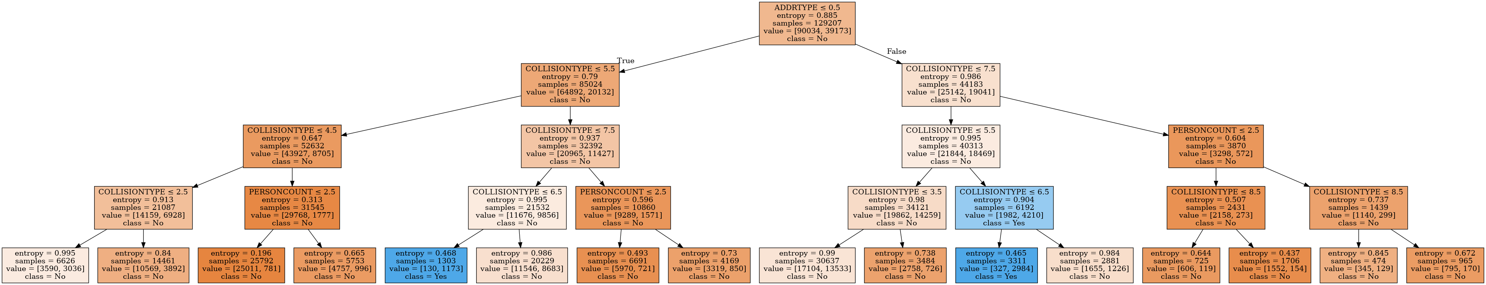
Decision Tree Classifier -
Decision Tree Accuracy: 75%

Slide 9
Discussion
First, I want you to look on the 2 blue blocks (leaves) on the fourth floor (don't count the first node)
The COLLISIONTYPE is worth 6 which means pedestrian.
Do you ask what is the point?
the point is it doesn't matter if the accident happened in block or at intersection
if there are pedestrians it will be deadly.

Slide 10
Conclusion
So, Transportation Authority of siattle USA pay attention please.
there is a high risk for pedestrian in your area, I demand to build more Infrastructure for pedestrian for instance:
Bridges instead intersection
More sidewalks
Fences between sidewalks to road
Integrated Street which the limit km/h is 30
Explanation to pedestrians how to behave safely in crossways

Slide 11
Thank you!
Tomer

